Slide 1
From Participation to Power: Creating Meaningful Roles for Youth in Organizational and Community Change John Weiss Ben Alfaro Lawanda Bradley Executive Director Alumnus Youth Action Coordinator Neutral Zone Neutral Zone Oasis Center Alicia Wilson-Ahlstrom Gina McGovern Senior Program Manager Design and Innovation Specialist Forum for Youth Investment Center for Youth Program Quality April 19, 2012
#readyby21

Slide 2
Objectives Agenda
Learn how to help students develop specific 21st Century Skills.
Learn practical ways to bring in authentic youth voice and leadership when designing projects and initiatives.
Take a Stand
Youth Driven Spaces: the Neutral Zone
Youth Mobilizers: the Oasis Center
Core Principles for Engaging Young People in Community Change
Applying What You’ve Learned
Next Steps

Slide 3
Take a Stand

Slide 4
The Neutral Zone
Where teens lead, create and innovate.

Slide 5
The Neutral Zone is a diverse, youth-driven teen center dedicated to promoting personal growth through artistic expression, community leadership and the exchange of ideas.
Neutral Zone is committed to :
Providing high-quality youth-driven activities and programs rooted in a positive youth development approach.
To target a diverse teenage audience.
To provide teens with 21st century skills.
To support authentic adult-youth partnerships, so that teens can engage in social change, creative expression, community leadership and cultural and educational enrichment.
Notes:
Neutral Zone is the model from which YDS practices and strategies developed.

Slide 6
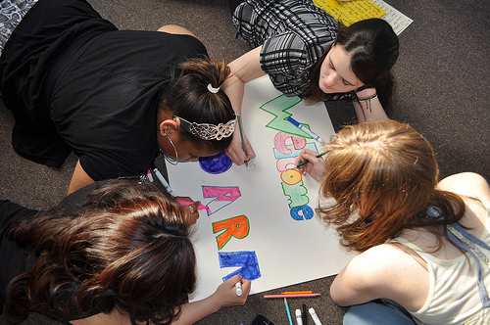
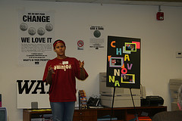
Youth-Driven Practices: @ the Program Level
Youth do the following …
Set Goals & Develop Strategic Plans
Facilitate Meetings
Run Dialogues
Curate Shows and Performances
Promote Events/Projects
Recruit and Train Participants

Slide 7
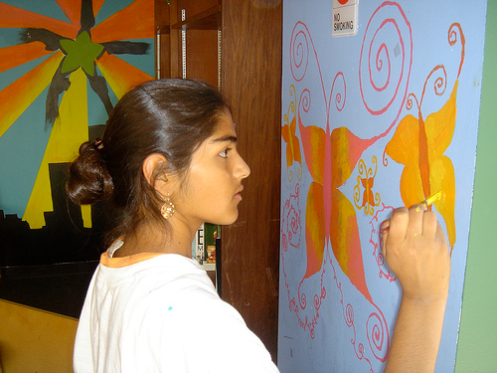
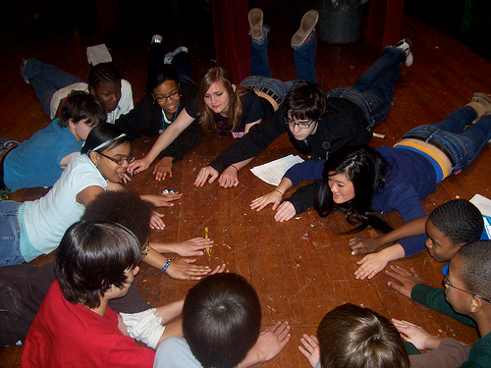
Youth-Driven Practices: @ the Organization Level
Youth do the following …
Establish Norms and Expectations
Own the Physical Space
Participate in Staff Hiring
Approve New Program Initiatives
Grant Making

Slide 8
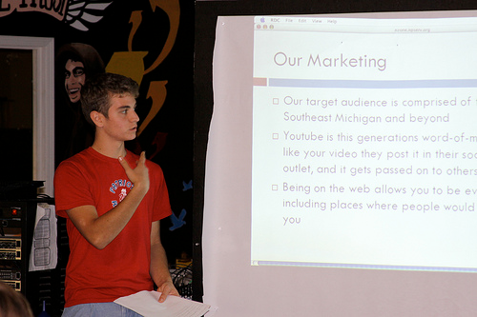
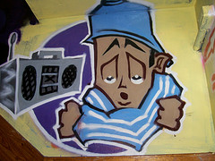
Youth-Driven Practices: @ the Governance Level
Youth do the following …
Serve on the Board and Board Committees
Partake in Organizational Strategic Planning
Support Community Outreach
Fundraise
Evaluate Programs

Slide 9
Program/Organizational Roles 21st Century Skills Continuum
Sense of Belonging
Active Engagement
Program Leadership
Organizational Leadership
Youth participate in community building
Youth own space
Youth set group norms
Programs and skill development based on youth interests
Youth recruit others
Youth lead goal setting & planning
Youth facilitate program meetings
Youth lead reflection
Youth support organizational strategic planning efforts
Youth engage in creating policy
Youth serve as ambassadors in the broader community
Youth participate in fundraising
Youth participate in staff hiring
21st Century Skills:
21st Century Skills:
21st Century Skills:
teamwork/ cooperation
decision making
planning/reflecting
critical thinking
problem solving
communication
community responsibility
prioritizing, planning, and managing
civic literacy
innovation
collaboration
financial literacy
prioritizing
ethics
accountability
self directed (learning)
creativity
Youth lead program evaluation
Youth engage in setting budgets and monitoring finances
Youth act as mentors to other youth
Youth help set goals and make plans for individual projects
Youth involved in generating ideas for their own initiatives, projects and programs
Youth actively give feedback and reflect on activities
personal responsibility
interpersonal skill development
cooperation
cultural competency
conflict resolution
21st Century Skills:

Slide 10
Oasis Center
Helping youth grow, thrive, and create positive change.

Slide 11
Oasis Center has a 41 year history rooted in youth support including positive youth development, crisis management, and youth leadership.
In the past 7 years, Oasis Center has broadened its scope to include youth and families from less privileged and culturally diverse backgrounds .
As a result, Oasis has created a model of youth organizing that is consistently transforming to meet the needs of the youth it engages while moving the social-change framework to the forefront of issue-based leadership.

Slide 12
Oasis Youth Mobilizers
Youth Action in Nashville, TN
Oasis Youth Mobilizers are an organized group of diverse high schools students that lend their voice and skills for positive social justice in their community. They build relationships, help communities identify keys issues and develop action strategies for change, and partner with caring adults to create a just environment for all people.
Issue-based leadership development
Service learning
Social & personal support

Slide 13
Integrating Youth Development
With Sustainable Campaigns
And Strategic Collaborations

Slide 14
Youth Development
Youth define the issue and the root causes
Sustainable Campaigns
Must be issues youth experience in their everyday lives
Opportunities for short term gains as well as far reaching systemic change
Strategic Collaborations
Understanding the importance of relationships with allies
Shared investment in issue and in youth
Skill development includes models of civic engagement,
Adults change policy –need them at the table
Using a social-change framework and emphasis on accountability
Power analysis-individual/community/systemic impacts

Slide 15
Youth Mobilizers Current Campaigns
Youth are connected to their communities by history, culture, and identity
Student Bill of Rights & Responsibilities
District Wide
Don’t Pull the Trigger: Youth Access to Illegal Weapons
Community Specific
Environmental Scans of Convenience Stores
Community Specific

Slide 16
Key Challenges
Transient nature of youth
Transportation
Structure of American business day prohibits youth involvement, i.e. meetings are usually between 8:00am – 3:00pm
Base-building
Youth Action in Nashville, TN

Slide 17
Questions & Answers

Slide 18
Core principles for youth engagement
Alicia Wilson-Ahlstrom

Slide 19
Core Principles for Youth Engagement
Design an outreach strategy.
Create a home base from which young people can operate.
Convey an intentional philosophy of change in which young people are central to success.
Identify issues central to and inclusive of young people’s perspectives.
Create youth and adult teams.
Build youth and adult capacity.
Provide individual support.
Create opportunities for young people’s sustained access and influence.

Slide 20
Applying What You’ve Learned
Look at the frameworks.
What are some things you already do?
What’s a new idea you want to bring back to your agency to wrestle with?
What do you do if you don’t have direct access to youth?
Consider on your own, then share with a partner.

Slide 21
Next Steps
Youth Engagement Resources from the Forum for Youth Investment
Ready by 21 Toolkit on Youth Engagement
Teen Advisory Council Guidebook and Youth Work Methods Courses from David P. Weikart Center for Youth Program Quality
Contact presenters

Slide 22
Contact Information
John Weiss Ben Alfaro Lawanda Bradley Executive Director Alumnus Youth Action Coordinator Neutral Zone Neutral Zone Oasis Center weiss@neutral-zone.org ben.alfaro@gmail.com lbradley@oasiscenter.org
Alicia Wilson-Ahlstrom Gina McGovern Senior Program Manager Design and Innovation Specialist Forum for Youth Investment Center for Youth Program Quality
alicia@forumfyi.org gina@cypq.org

Slide 23
Header
Body Text

Slide 24
Youth report improvements in relationships with adults and investment in program.
All significant at p < .05.

Slide 25
Youth observe no change or less youth responsibility for organizational management; likely to be greater awareness of possibilities.
Completely adults
Equally shared
Completely youth
Adapted from Kalamazoo Youth Development Network, 1999.
Notes:
Became aware of how they weren’t involved

Slide 26
Youth report improvement in self-management skills and larger connections.
Strongly disagree
Strongly agree
YES 2.0, Hansen & Larson, 2005, adapted. All significant at p < .05.
Notes:
All test results on the mean comparisons are statistically significant.

Slide 27
Youth report improvement in organizational management and team leadership skills.
YES 2.0, Hansen & Larson, 2005, adapted. All significant at p < .05.
Strongly disagree
Strongly agree

Slide 28
Youth described many benefits:
Communication skills
“I'm more organized and more professional when I speak to people, and my actions.”
“You know how… you ask a person a question, you expect a certain answer and that, but you may not have asked the question in the right way…so they [give] you a different answer than you was expecting. I learned how to ask the right questions.”
“At first I wanted to be sassy, but then I was like, ‘No. Let your knowledge speak.”
“ if the students don’t feel that it’s right, they will address it to the adults and we will actually sit there and compromise and work something out.”

Slide 29
Youth described many benefits:
Perspective-taking
“Um, we've learned like tolerance. We've learned what it takes to be better at, not stereotype of things because we get stereotyped. But everybody does it self-consciously, but we've learned how to put ourselves in other people's shoes and see it from their point of view. “
Confidence to assert one’s ideas
“It's like seeing that like, like the confidence you gain from, like, being, like, ‘I have a good idea,’ and it's not just gonna sit there as an idea that'll be like, ‘Oh, well, that's a cute idea’ and nothing ever came of it. Like, it's, like, knowing how to put your ideas and, like, how to actually make them happen.”

Slide 30
Youth described many benefits:
Management skills
“We’ve also learned how, like as the leaders, to run like a whole meeting before.”
Resource development
“So we're writing new grants. So money definitely kind of plays an issue in it because, you know, we have to have the funds to make this place come alive.”
Using information to support change efforts
(Trying to change a policy) “Like some people didn't want it to happen, you know…I guess they were trying to say that it wasn't the biggest problem as it was. But…we show the biggest problems and stuff that was actually proven, it had statistics, it was really easy.”

Slide 31
Youth described many benefits:
Skills that will help in the future
“I think, um, over the past year we've all learned those skills that are not just for [this organization], but they're gonna take us in our life.
“…or when you, uh, actually get out on your own. Not, not only is it good for like resumes and different applications, but, uh, it helps you learn different things and you gain experience through…more life skills.”

